Slide 1
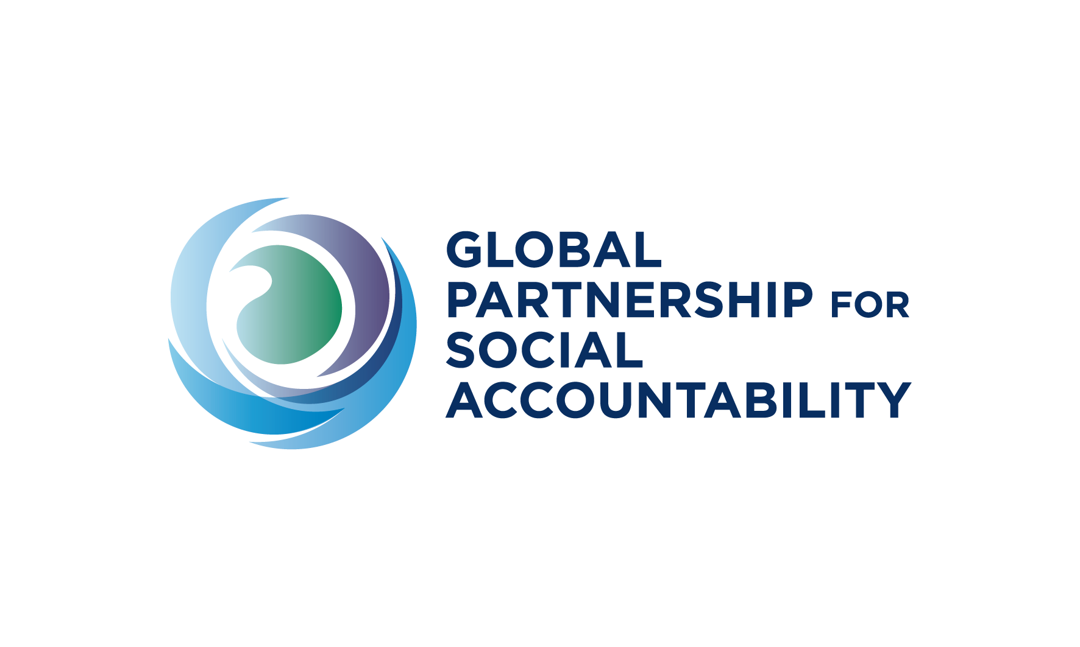
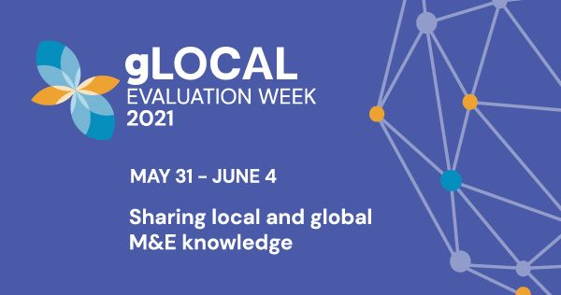

theory at mid-level: WHY AND HOW?
Florencia guerzovich
@GUERZOVICH
June 1, 2021

Slide 2
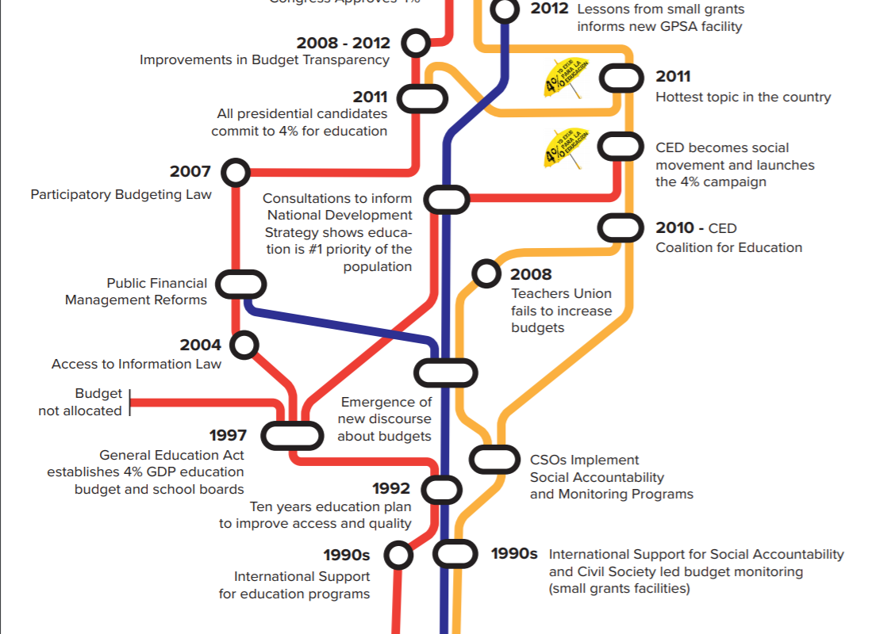
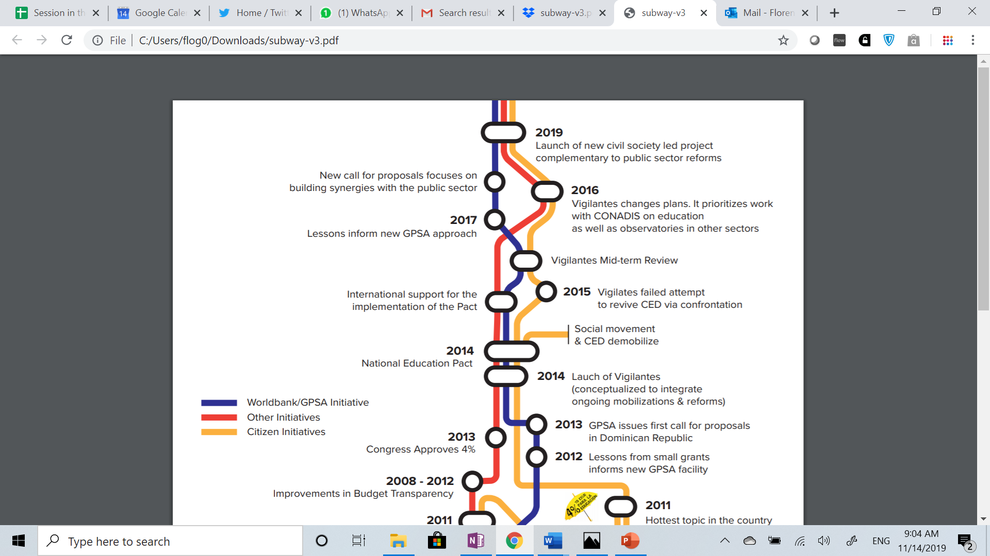
Notes:
In the 1990s, in the Dominican Republic, the WB much like other organization provided funds for social accountability –e.g. largely focused on budget transparency and monitoring.
That funding often was not coordinated with other funding, including funding in the education sector.
By 2011 education funding becomes the hottest issue in the country with mass mobilization and budget transparency one tool for unlocking more financing for education.

Slide 3
Notes:
Around that time the GPSA was being set up at the WB and lessons from countries like the DR were being incorporated.
For example, while global call for proposal was issued, in the DR the call was focused on areas that seemed to make sense given mass mobilizations and greater finance for education.
BUT by 2 years into the project context changed. People where demobilized and the project had to course-correct.
It also became more clear that GPSA should broker synergies with public sector reforms in the education by design to focus on the problems that seem to matter most in the education sector.

Slide 4
Formal starting point (2012)
Notes:
What you see in the case of the DR is also part of the journey to specify how the GPSA expects to contribute to change. The program started with a formal TOA Commissioned to an M&E expert.
It may have reflected some of the funding pre-GPSA.
It was not used by the GPSA in practice due to “gap” with field expectations.

Slide 5
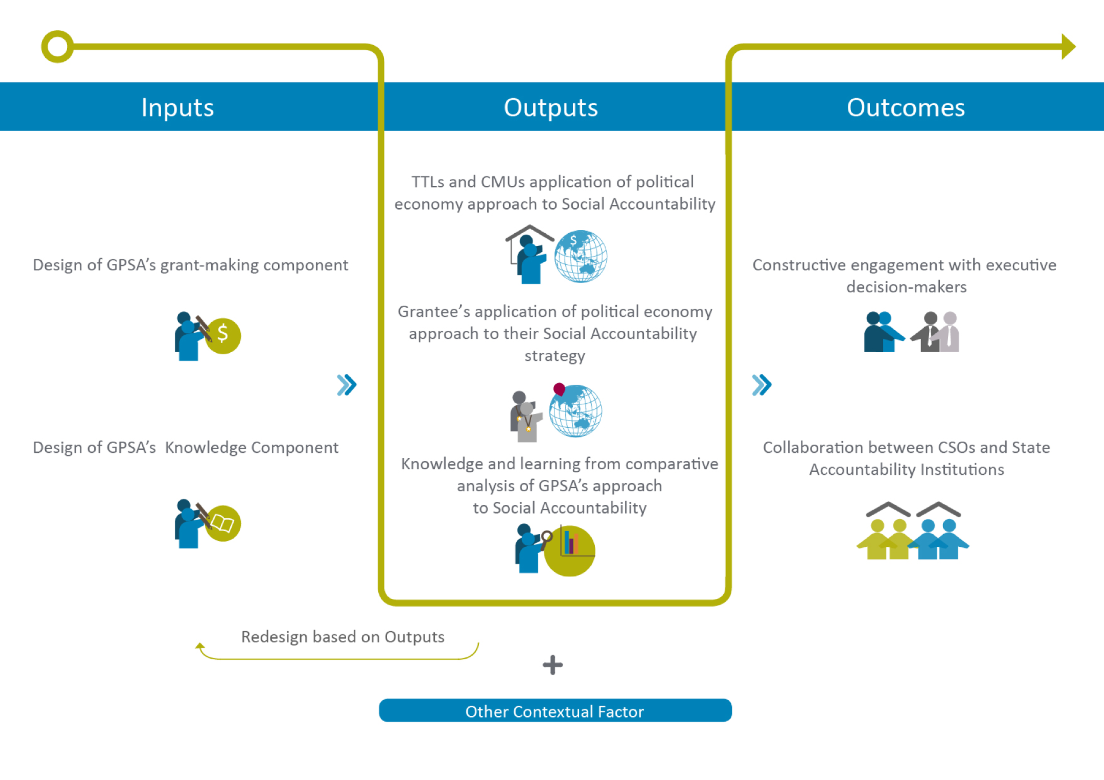
Operational course-correction (2014)
Notes:
2014-5: Assumptions from consultations with stakeholders in the field, literature reviews, in-house tacit knowledge, 1200+ applications for funding. GPSA partly used this TOA.

Slide 6

misfit Theory for collaborative social accountability
=/=
“useful merl” for collaborative social accountability
Notes:
2016: GPSA team learned TOA had to be course-corrected, from processes like the DR one
*some assumptions did not hold,
*omitted important processes, such as the integration with sectoral reforms
*normative assumptions contributed to unintended consequences
* Language that we used in GPSA’s 2014 TOA – strategic social accountability – was conceptually stretched and, thus unhelpful to capture what GPSA stakeholders were doing
We needed new theory, but it took four years of using the instruments of the MERL system to test, reflect, learn what a useful GPSA’s TOA centered on collaborative social accountability could look like

Slide 7


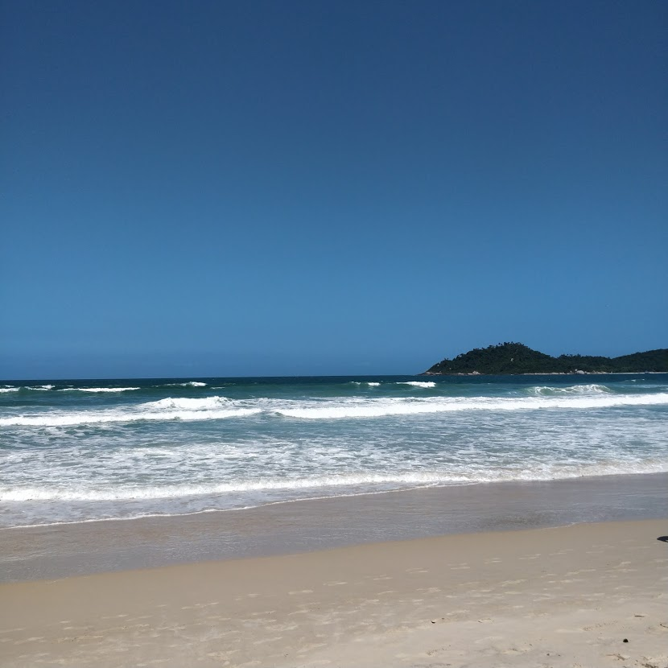
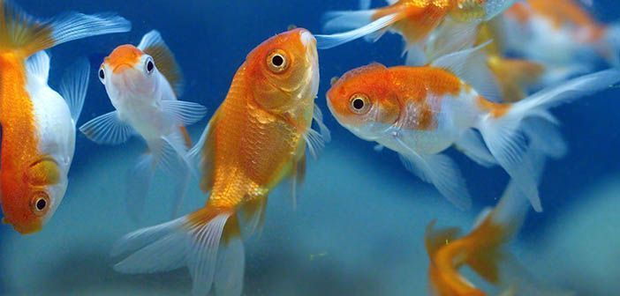
“USEFUL” FOR WHAT?
BROKER
“PRODUCTIVE” EXCHANGES AMONG SUB-SETS
OF PARTNERS
IMPROVE HOW WE & OTHERS
DEFINE & SUPPORT
THE SYSTEM WHERE SWIMMING HAPPENS (OR MIGHT HAPPEN)
FACILITATE SWIMMING IN ONE CONTEXT IN REAL TIME
This Photo by Unknown Author is licensed under CC BY-NC-ND
This Photo by Unknown Author is licensed under CC BY-NC-ND
Notes:
Useful for what GPSA stakeholder decision making?
GPSA has 3 different mandates
They can be in tension because they ask different questions, provide different information, and different stakeholders need different information to make decisions.

Slide 8
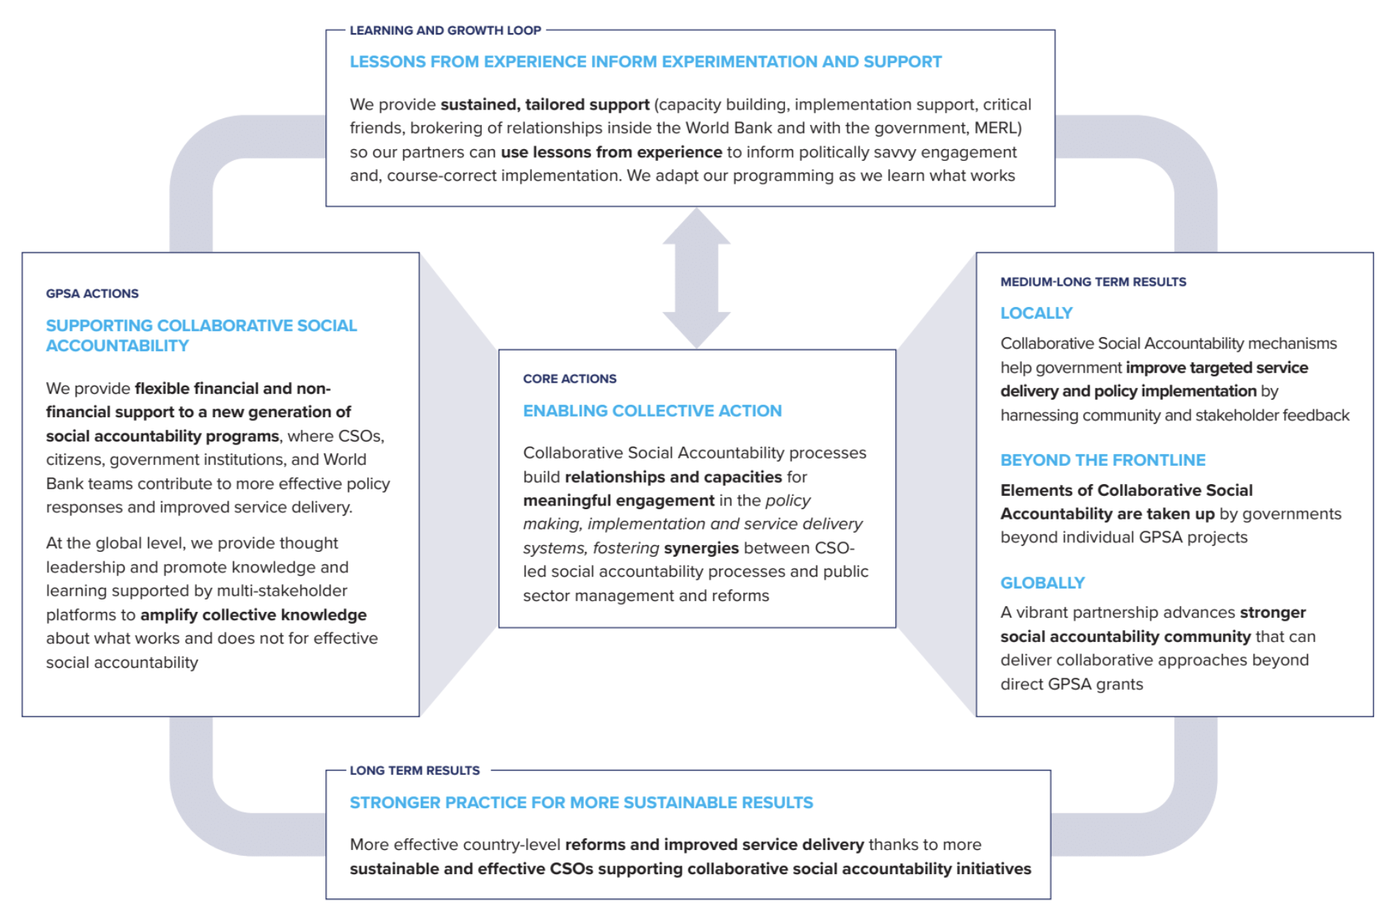
GPSA’s theory of action at a glance (2020)
Notes:
The “working” compromise is the GPSA’s TOA, which was built through a combination of induction and deduction, by 2020 focusing on priority issues.

Slide 9
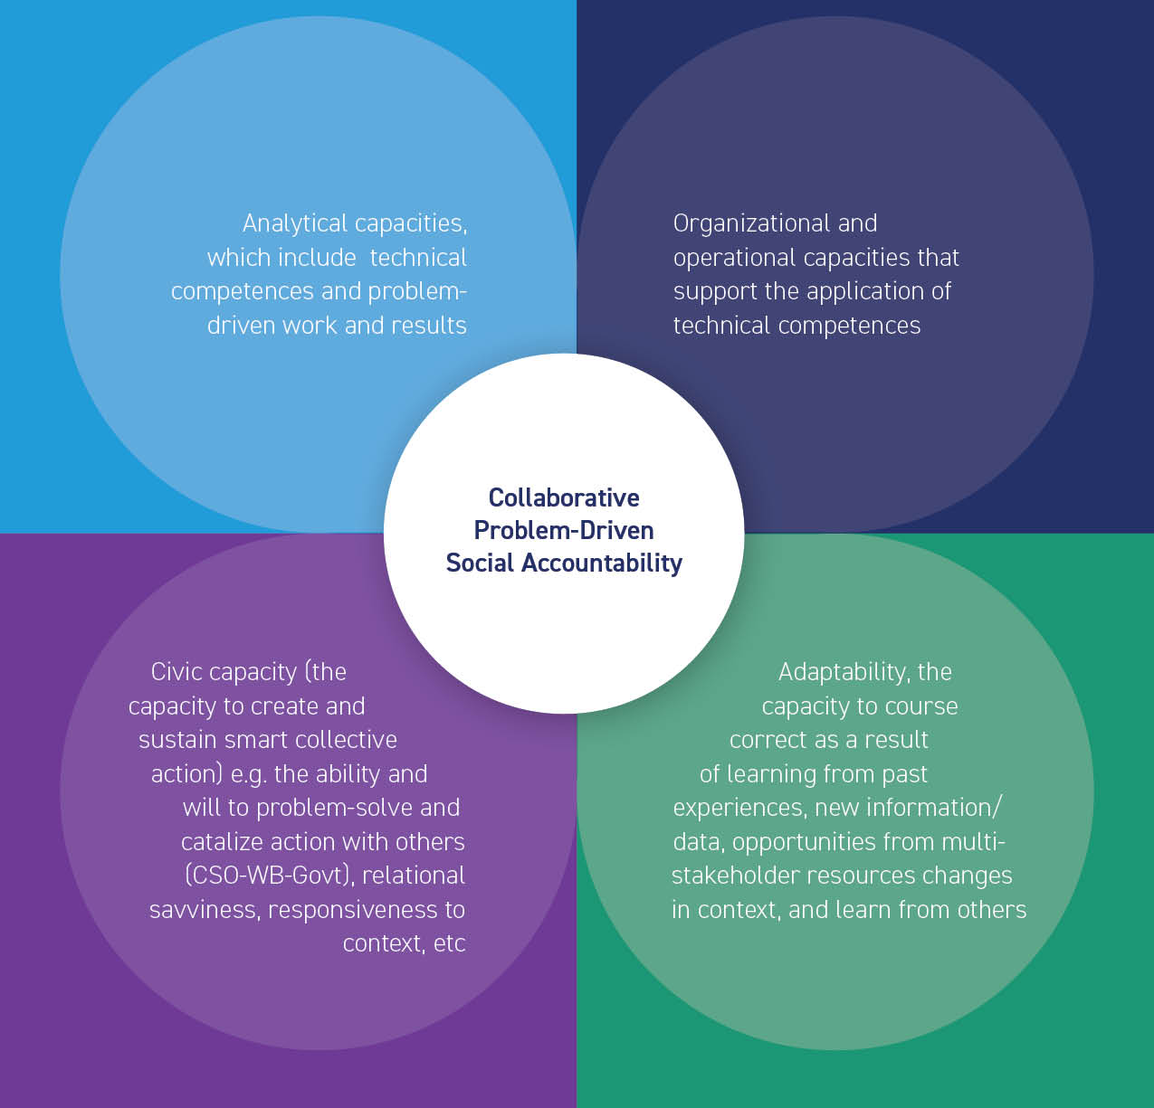


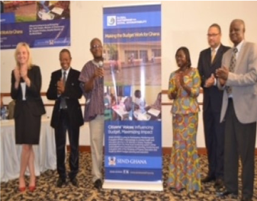
CROSS-CUTTING priorities: “useful” MERL COMPROMISE
KEY CAPACITIES FOR DOING THE WORK
COMPLEX PROBLEM-SOLVING PROCESSES & RESULTS
POWER OF SYNERGY & COHERENCE
PATHS TO SCALE, SUSTAINABILITY
(SYSTEM CHANGE)
VIA RESONANCE
Notes:
Some of the cross-cutting issues that GPSA stakeholders find most useful for MERL over the years.
Help Illustrate another problem of misfit theory beyond the TOA.
We have a great realist evaluation of the contribution of social accountability to system strengthening in Indonesia.
But when we read the component about scale, the findings of the evaluation did not match the tacit learning we were hearing from our colleagues at the WB and public officials. Part of the challenge was that certain assumptions were not included in the TOA that the evaluation looked into – and created a blindspot.
So in newer iterations of the MERL system we started to focus on resonance explicitly, aligned with the TOA and are muddling through like James did.

Slide 10


BUILDING THEORY BEYOND THE METHODOLOGICAL DIALOGUE OF THE DEAF
=
FOCUS ON MEANINGFUL SIMILARITIES & DIFFERENCES ACROSS SUB-SETS OF PRACTICE
PIVOTS OVER TIME IN ONE COUNTRY
VARIATIONS ACROSS SECTORS & PROBLEMS WITHIN SECTORS
DIFFERENT TYPES OF FUNDING & IMPLEMENTING ORGANIZATIONS
OTHERS
Notes:
To move beyond the 2-camp dialogue of the deaf, we opted to stay outside the methods battle and universal propositions
Focusing on patters across sub-sets of cases (the mid, in mid-level) became useful to learn from GPSA MERL
Here are some of the factors that seem to be helping us go deeper

Slide 11


gradually changing other merl components
Key Evaluation Questions that matter (mid-point vs final)
Type and Focus of Meaningful Priority indicators, Reporting Tools at Project and Portfolio levels
Cycles of “muddling through”, systematization & standardization with broad space for adaptation
Budgets
Length & capacities of evaluators
Fit for purpose methods
MERL Communication, Etc, etc.
This Photo by Unknown Author is licensed under CC BY-SA
This Photo by Unknown Author is licensed under CC BY-SA
This Photo by Unknown Author is licensed under CC BY-SA
This Photo by Unknown Author is licensed under CC BY-SA
This Photo by Unknown Author is licensed under CC BY-SA
This Photo by Unknown Author is licensed under CC BY-SA
This Photo by Unknown Author is licensed under CC BY-SA
This Photo by Unknown Author is licensed under CC BY-SA
This Photo by Unknown Author is licensed under CC BY-SA
This Photo by Unknown Author is licensed under CC BY-SA
This Photo by Unknown Author is licensed under CC BY-SA
This Photo by Unknown Author is licensed under CC BY-SA
Notes:
There is a part 2 to this conversation that I want to hint at closing
Mid-level theory can help us move forward, but it is only one piece of the puzzle at TOA
It must change along other resourcing and tools that enable the “potential” of theory to pay –off
All require compromise in a world of scarce resources and competing interests

Slide 12
ANNEX

Slide 13
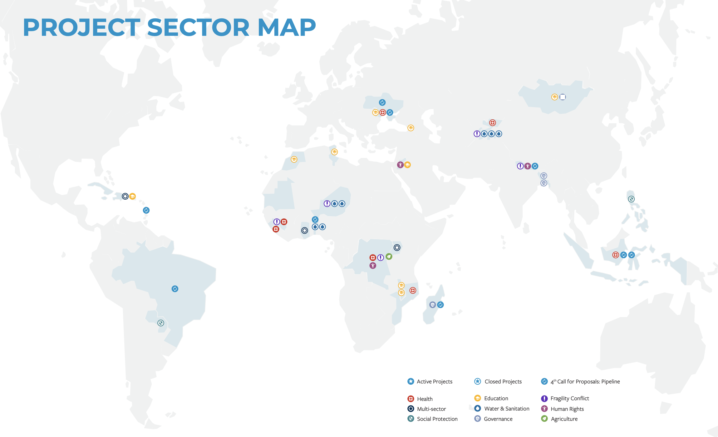
GPSA: A DIVERSE PORTFOLIO SINCE 2012

Slide 14
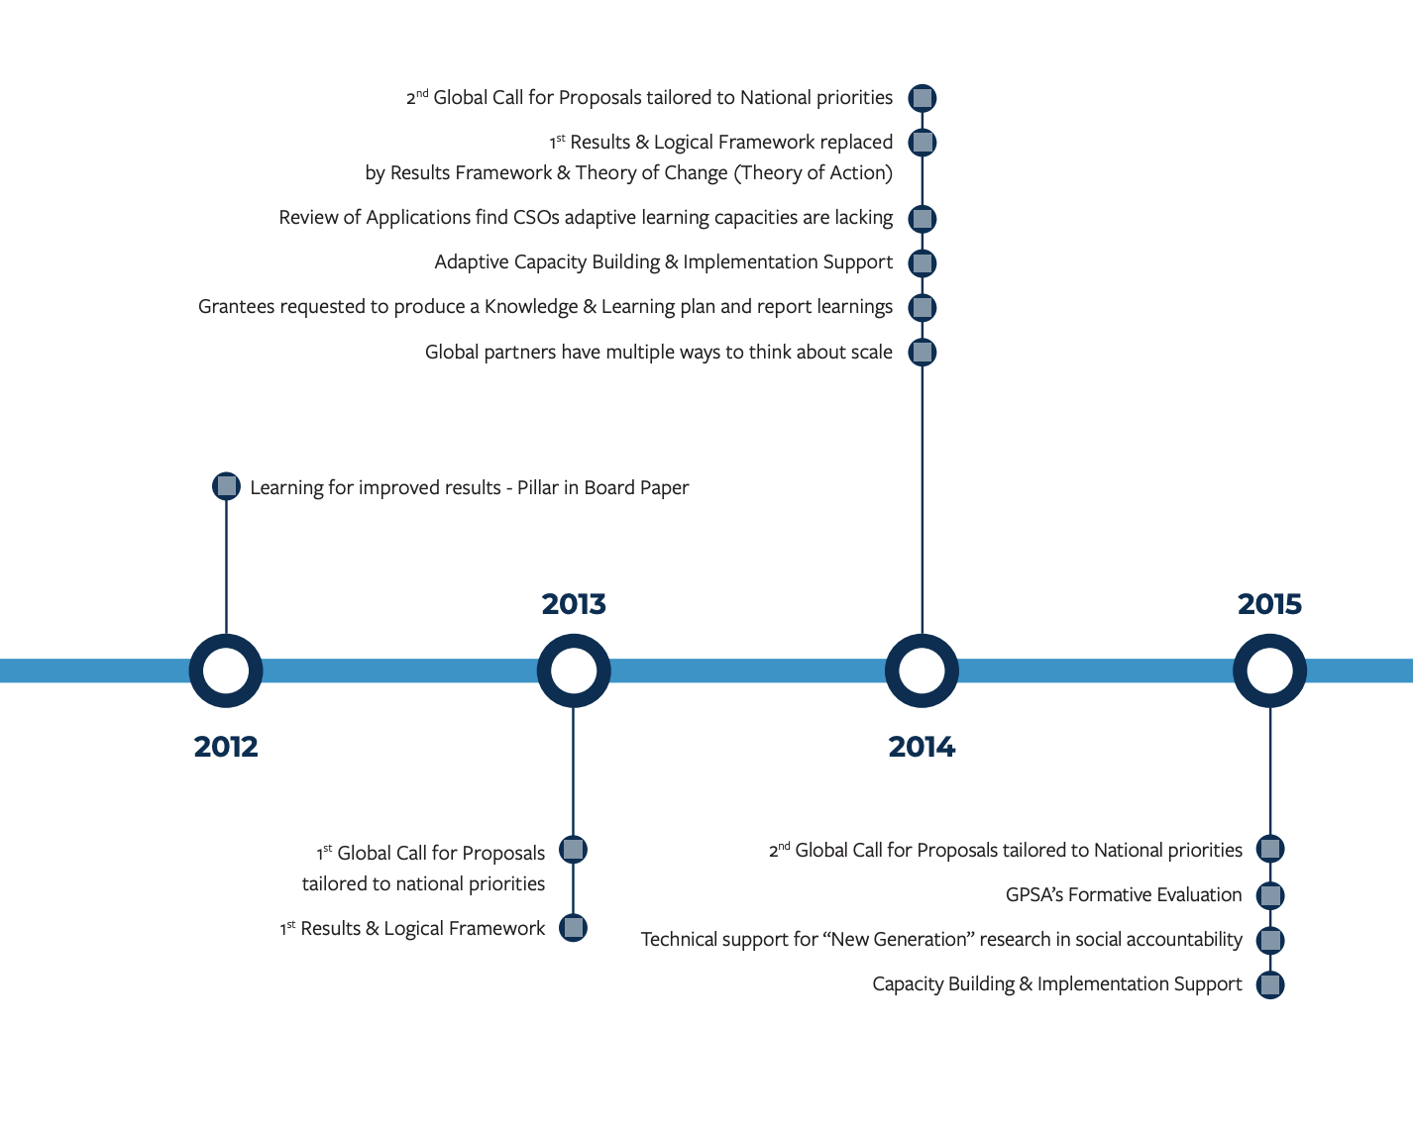
Gpsa’S Theory of Action & merl instruments ARE WORK IN GRADUAL PROGRESS

Slide 15
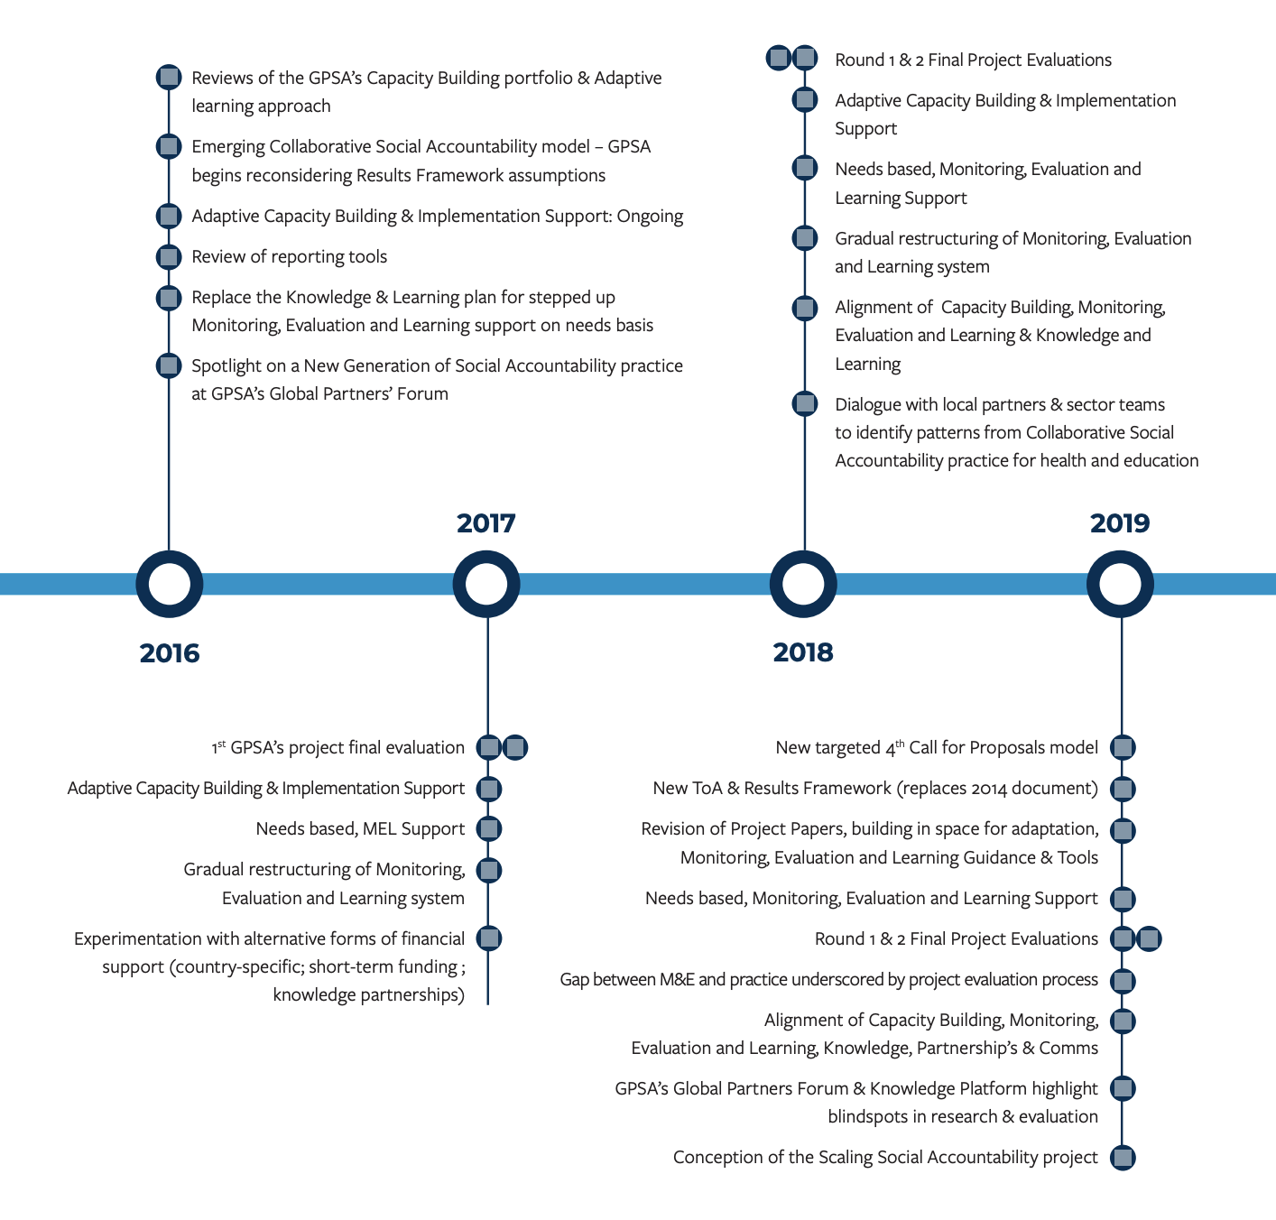

Slide 16
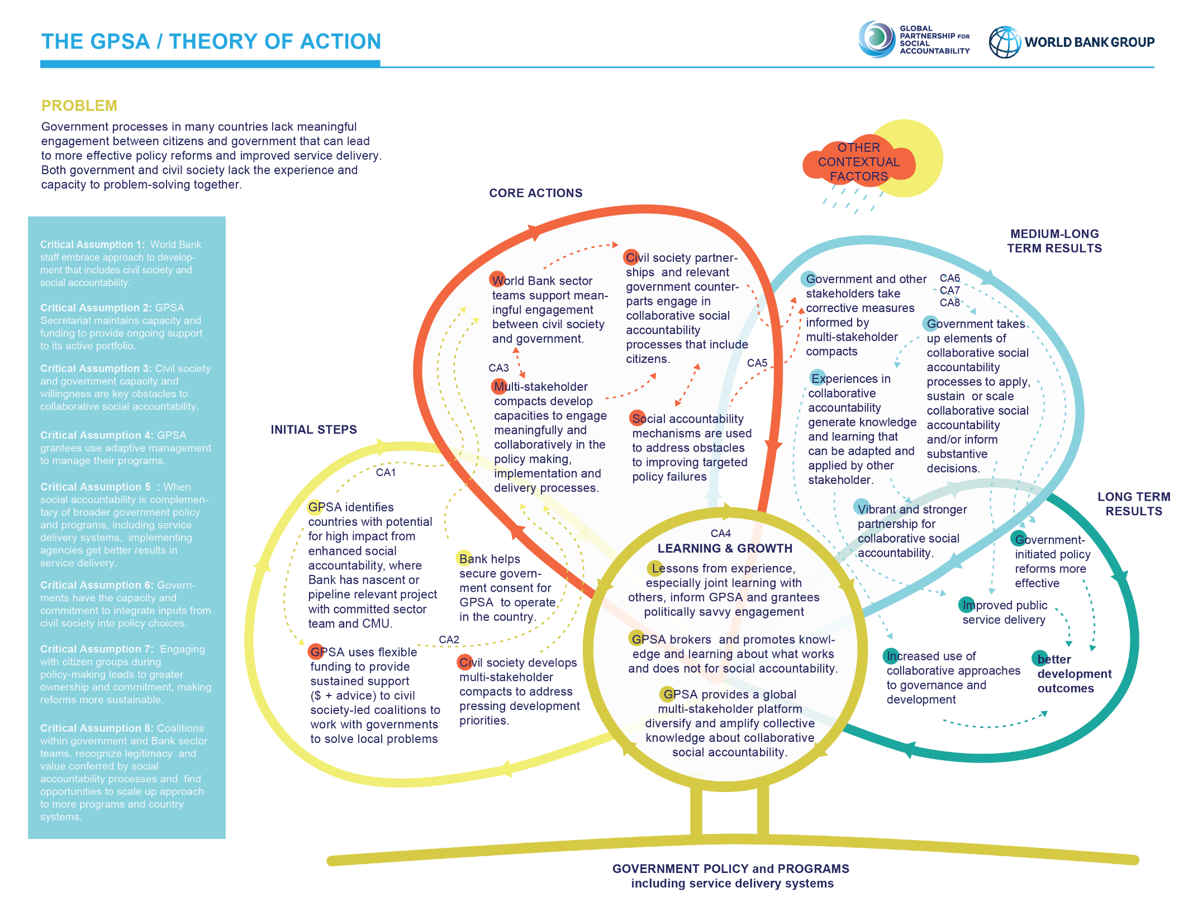
2020

Slide 17
CROSS-CUTTING priorities: “useful” MERL COMPROMISE
COMPLEX PROBLEM-SOLVING PROCESSES & RESULTS
The evaluation of our project in Indonesia is the first evaluation to map how collaborative social accountability changes power dynamics & strengthens health systems.
PATHS TO SCALE, SUSTAINABILITY
(SYSTEM CHANGE)
VIA RESONANCE
The evaluations of our projects in Moldova and Georgia validate the potential of our approach to scale via collaboration between CSO partners, governments and World Bank teams.
In DRC, the evaluation identifies that other development partners’ operations can also open routes for uptake beyond our investment.
KEY CAPACITIES FOR DOING THE WORK
The mid-term evaluations of projects in DR, Mongolia, Uganda and reporting helped understand what it takes to do the work and whether / how GPSA can provide non-financial support.
POWER OF SYNERGY & COHERENCE
The evaluation of our projects in Ghana shows why and how our CSO partners learned that building synergies with sector ministries was more productive than stand-alone participatory budgets.
Notes:
This slide maps some of the cross-cutting issues that GPSA stakeholders find most useful for MERL over the years.
Illustrate another challenge of misfit theory
We have a great realist evaluation of the contribution of social accountability to system strengthening in Indonesia.
But when we read the component about scale, the findings of the evaluation did not match the tacit learning we were hearing from our colleagues at the WB and public officials. Part of the challenge was that their assumptions were not included in the TOA that the evaluation looked into – and created a blindspot.
So in newer evaluations we started to ask about resonance explicitly and built it into the TOA

Slide 18
Select ADDITIONAL DOCUMENTATION
Global partnership for social accountability and establishment of a multidonor trust fund | https://documents.worldbank.org/en/publication/documents-reports/documentdetail/772371468325192991/global-partnership-for-social-accountability-and-establishment-of-a-multidonor-trust-fund
The Global Partnership for Social Accountability : Theory of Action | https://documents.worldbank.org/en/publication/documents-reports/documentdetail/425301607358292998/the-global-partnership-for-social-accountability-theory-of-action
Citizen Voice and Action for Government Accountability and Improved Services : Maternal, Newborn, Infant and Child Health Services : Final Evaluation Report | https://documents.worldbank.org/en/publication/documents-reports/documentdetail/331651607355519716/final-evaluation-report
Reinforcing Social Accountability in Health Services in Sud Kivu and Kongo Central Provinces : Final Evaluation of the GPSA-CODESA Project | https://documents.worldbank.org/en/publication/documents-reports/documentdetail/883991607354429777/final-evaluation-of-the-gpsa-codesa-project
Making the Budget Work for Ghana : Final Evaluation | https://documents.worldbank.org/en/publication/documents-reports/documentdetail/418131607356580690/making-the-budget-work-for-ghana-final-evaluation
Creating Space for Social Accountability : The Global Partnership for Social Accountability | https://documents.worldbank.org/en/publication/documents-reports/documentdetail/438411606889358739/creating-space-for-social-accountability-the-global-partnership-for-social-accountability
Adaptive Learning | https://documents.worldbank.org/en/publication/documents-reports/documentdetail/714911606890716555/adaptive-learning
What Next for Strategic Social Accountability? | https://documents.worldbank.org/en/publication/documents-reports/documentdetail/512441606890568737/what-next-for-strategic-social-accountability
Supporting Politically Smart Social Accountability | https://documents.worldbank.org/en/publication/documents-reports/documentdetail/298621606889355029/supporting-politically-smart-social-accountability
How are GPSA’s Partners Thinking About Scale and Trying to Achieve It? | https://documents.worldbank.org/en/publication/documents-reports/documentdetail/654161606890404650/how-are-gpsa-s-partners-thinking-about-scale-and-trying-to-achieve-it
The Learning Crisis and Its Solutions : Lessons from Social Accountability for Education | https://documents.worldbank.org/en/publication/documents-reports/documentdetail/468311606905286817/the-learning-crisis-and-its-solutions-lessons-from-social-accountability-for-education
Aligning Actors for Learning : The Evolution of Social Accountability in the Dominican Republic’s Education Sector | https://documents.worldbank.org/en/publication/documents-reports/documentdetail/462891606909232662/aligning-actors-for-learning-the-evolution-of-social-accountability-in-the-dominican-republic-s-education-sector
Capacity and Implementation Support Area : Portfolio Performance Review | https://documents.worldbank.org/en/publication/documents-reports/documentdetail/893741606909911810/capacity-and-implementation-support-area-portfolio-performance-review
Integrating Adaptive Learning in Grant-Making : The Case of the GPSA | https://documents.worldbank.org/en/publication/documents-reports/documentdetail/116071606910702575/integrating-adaptive-learning-in-grant-making-the-case-of-the-gpsa
How Social Accountability Strengthens Cross-Sector Initiatives to Deliver Quality Health Services? | https://documents.worldbank.org/en/publication/documents-reports/documentdetail/600891606911830725/how-social-accountability-strengthens-cross-sector-initiatives-to-deliver-quality-health-services

