Slide 1
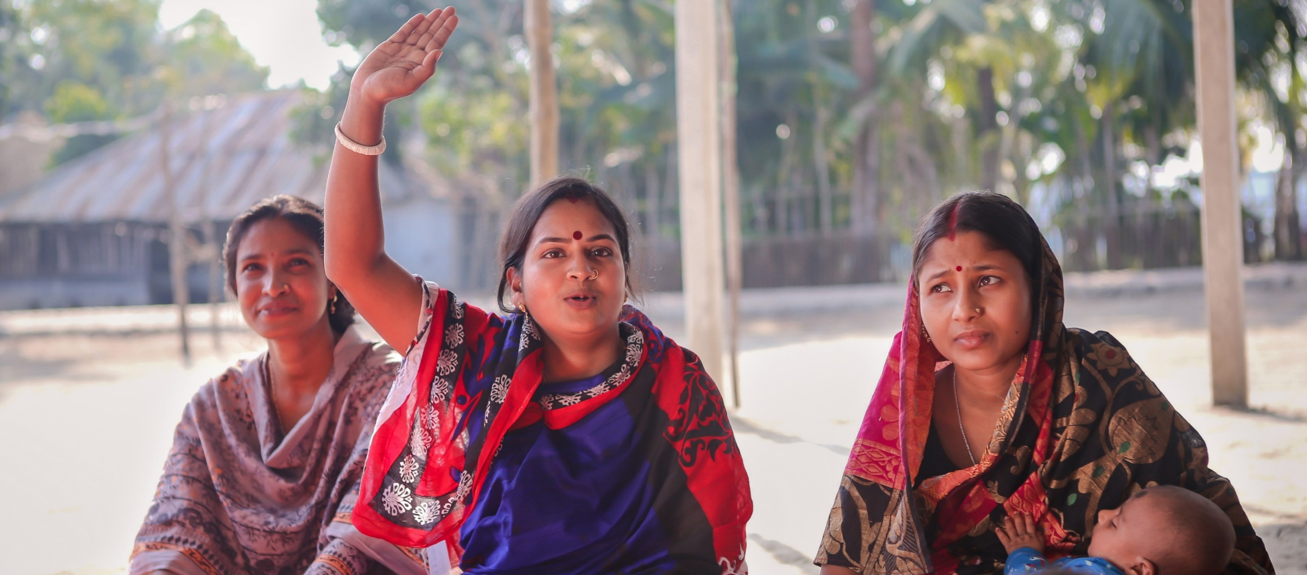
Mid-Level Theory in Social Accountability: Citizen Voice and Action in the Nobo Jatra Program in Bangladesh
James D. Long
Associate Professor of Political Science
University of Washington

Slide 2
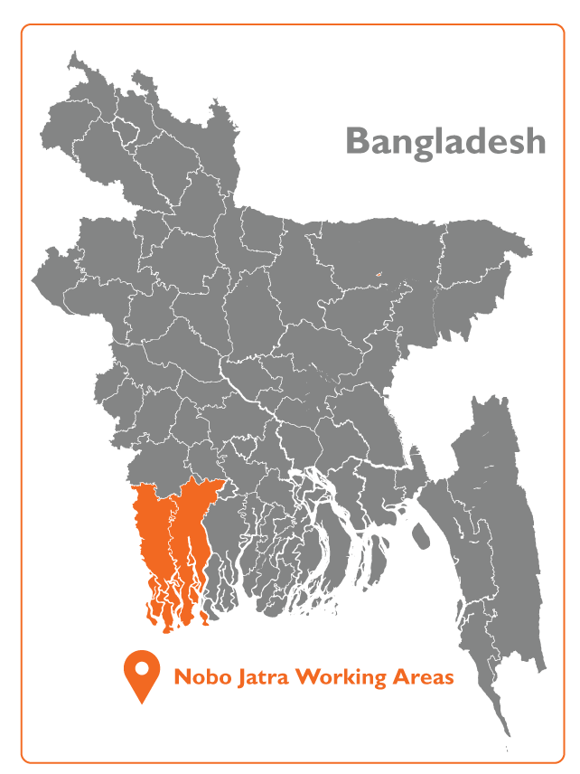
Overview
‘Nobo Jatra-New Beginning’
USAID’s Resilience Food Security Activity implemented by World Vision.
2015
2020
2021
2022
Implementation
sustainability,
systems strengthening
and transition

Slide 3
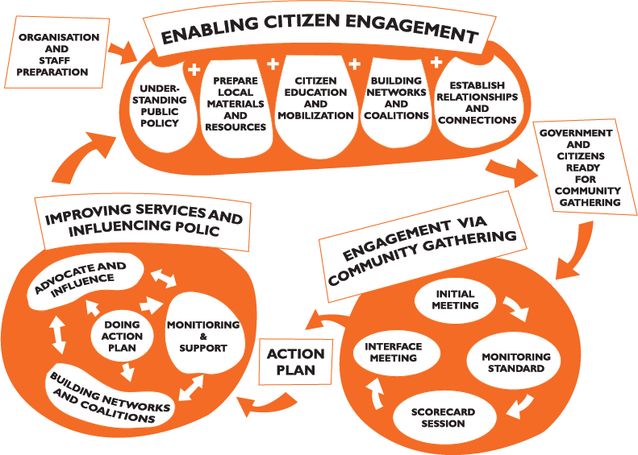
Social Accountability Approach in Nobo Jatra
Sectors Prioritized for
Improving Accountability
1. Health-Community Clinic
(#119) and Union Health &
Family Welfare Center (33)
2. WASH-Union WATSAN
Committee (#40)
3. Agriculture-Union Agricultural
Service Center/Unit (#40)

Slide 4
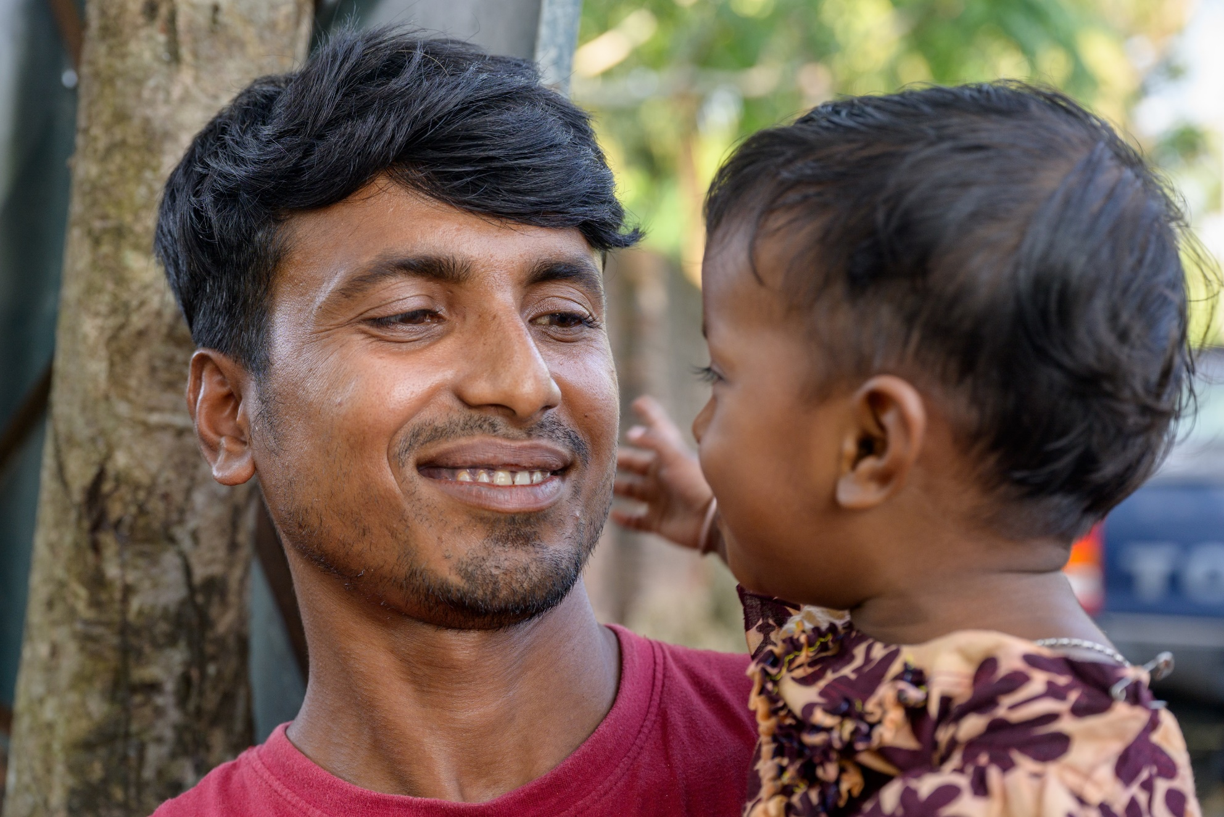
Mid-level theory for sustainability?
Initial skepticism of CVA impact at all levels
But in particular: need for evaluation for sustainability/ systems strengthening

Slide 5
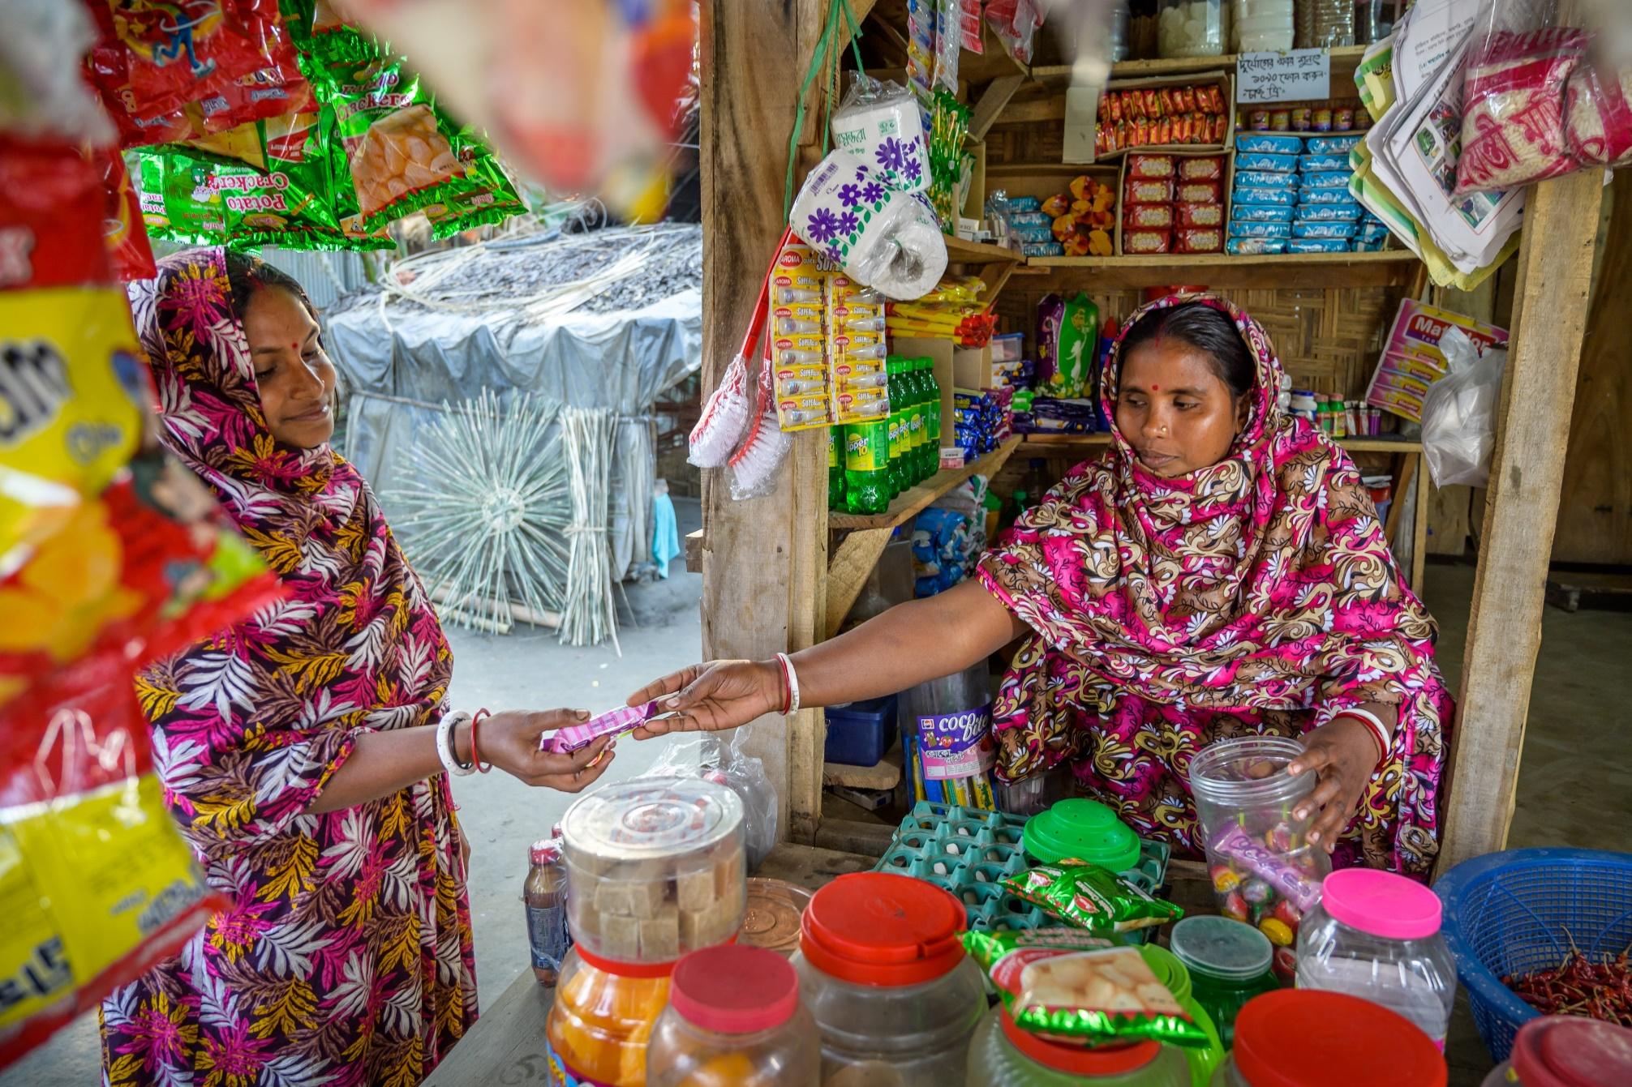
Sustainability
Evidence of CVA’s impact on policy dialogue:
Critical at local, regional, and national levels
Works at granular level and trickles up; also trickles down
Amplifies citizen feedback through collective voice – harder to dismiss than individual complaints
Highlights objective gaps in government standards
Inspired government responsiveness
Notes:
Policy Dialogue at local, meso (regional), and national levels is critical for sustainability of CVA
Did sustainability worked through policy dialogue?
Result: Yes! And this can continue!
“policy dialogue” can work at granular level and “trickle-up”
local change mattered to upazila, upazila change mattered to regional and national level
amplify voice not just to “name and shame,” but actually develop joint action plans
all manner of new budget allocations, policy reforms, legislation, attention to personnel, accountability mechanisms directly/indirectly inspired by CVA
instances of knowledge-sharing and linkages
much of this “ad hoc” and without a theory of change framework, but a “win is a win”

Slide 6
Conclusions:
Political economy mapping through iteration
Evaluation of sustainability/systems strengthening requires mid-level theory
Wider methods toolbox but with same aim: evidence-to-action to build back better
Notes:
Policy Dialogue at local, meso (regional), and national levels is critical for sustainability of CVA
Did sustainability worked through policy dialogue?
Result: Yes! And this can continue!
“policy dialogue” can work at granular level and “trickle-up”
local change mattered to upazila, upazila change mattered to regional and national level
amplify voice not just to “name and shame,” but actually develop joint action plans
all manner of new budget allocations, policy reforms, legislation, attention to personnel, accountability mechanisms directly/indirectly inspired by CVA
instances of knowledge-sharing and linkages
much of this “ad hoc” and without a theory of change framework, but a “win is a win”

Slide 7
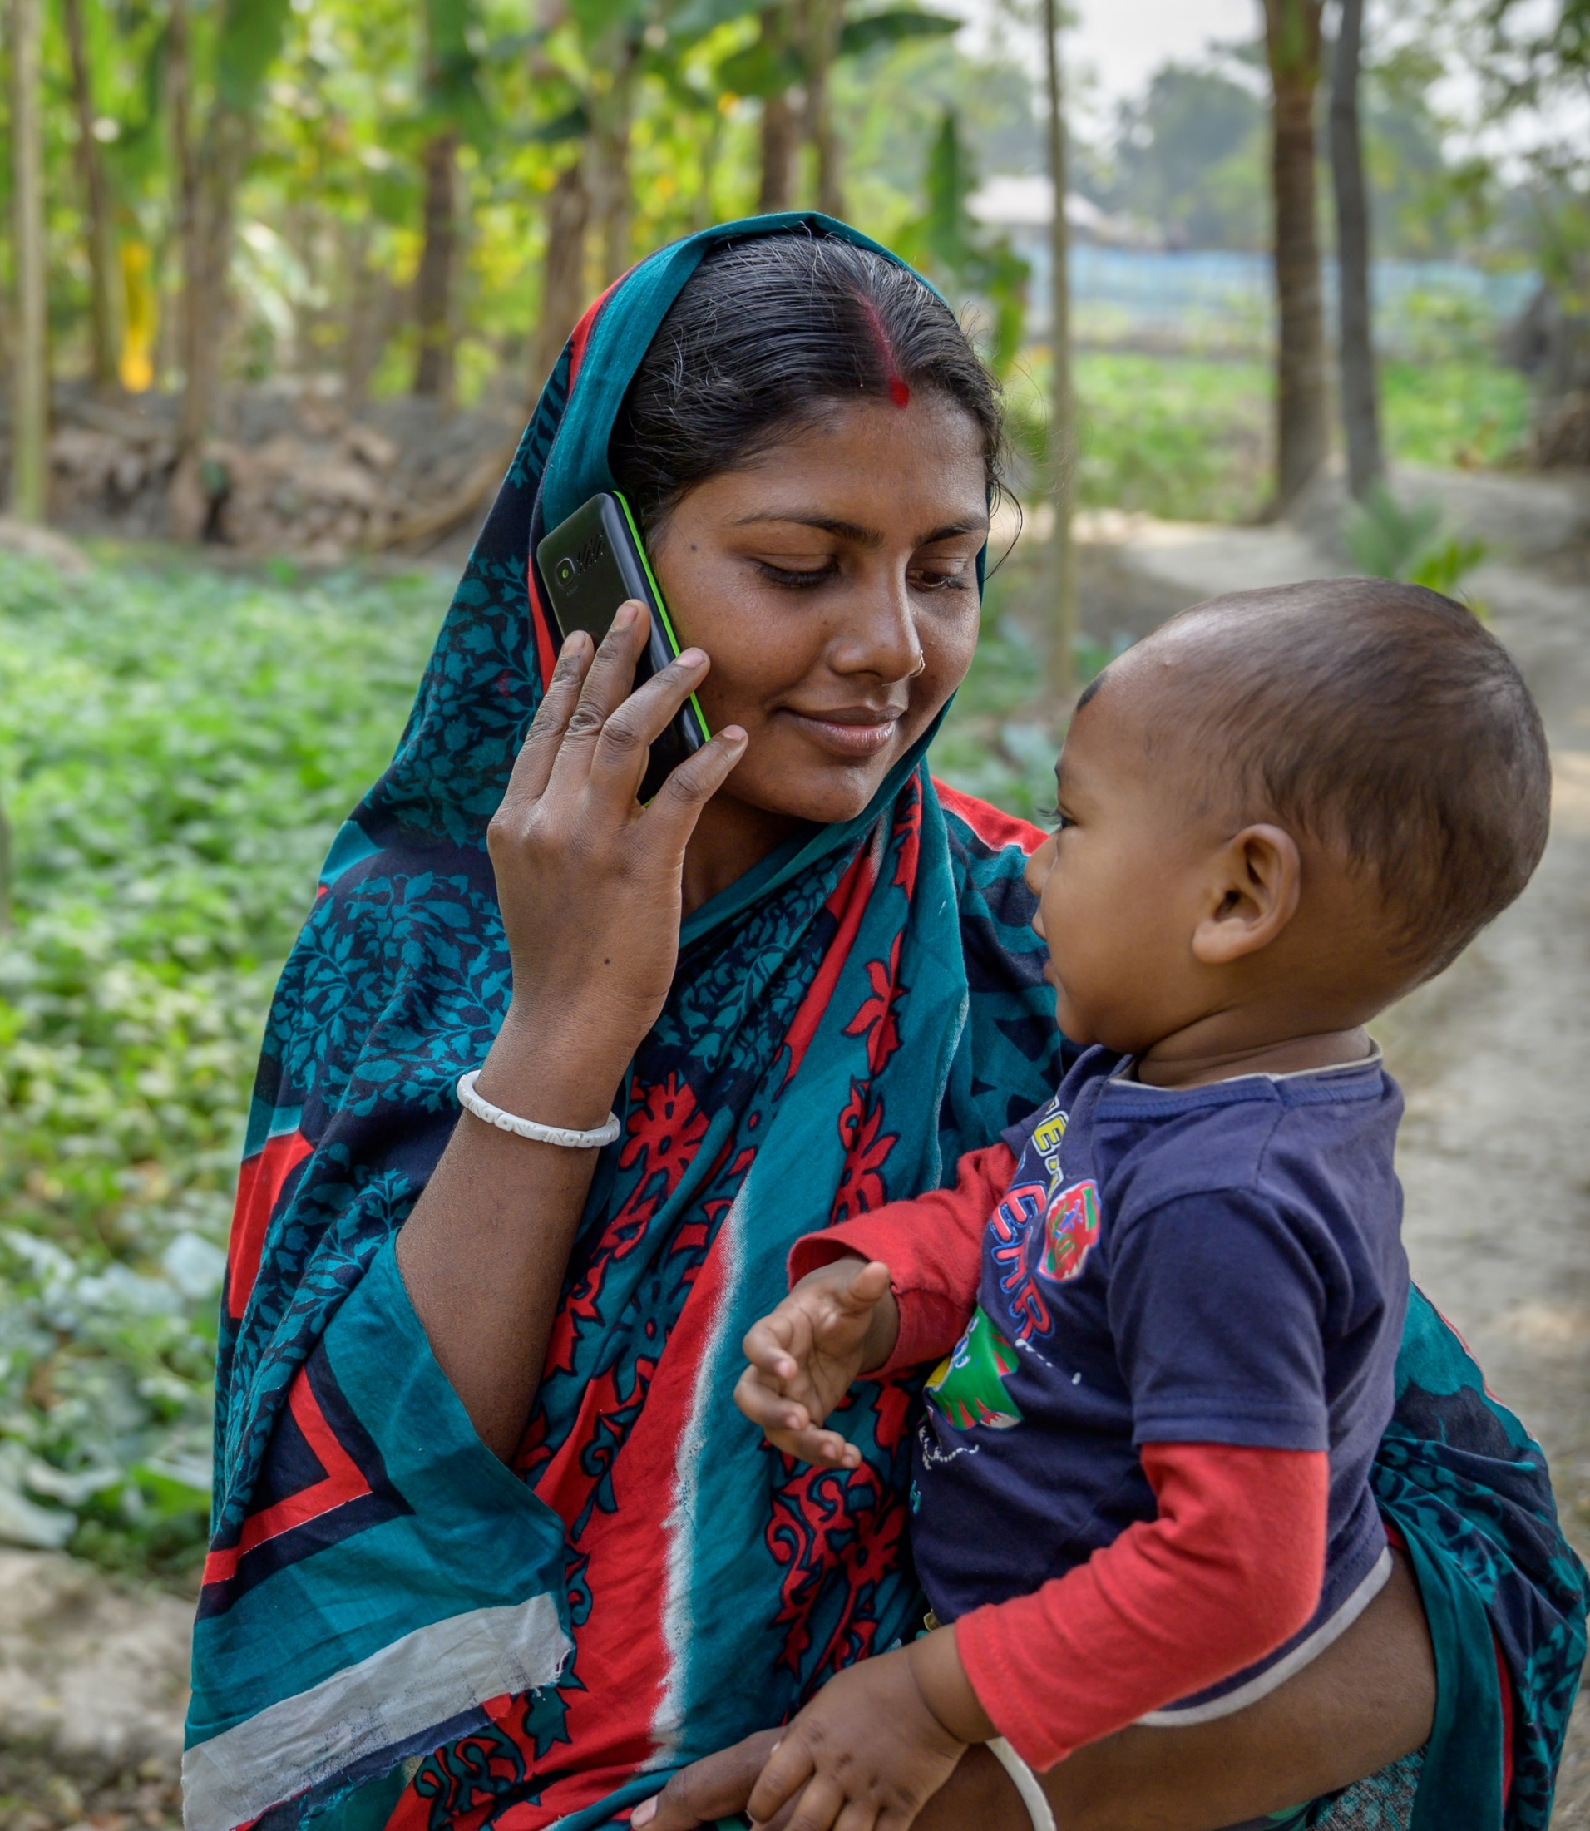
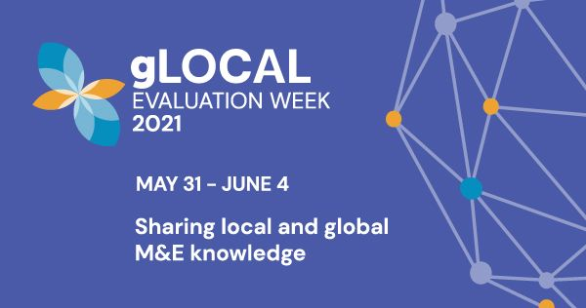
Thank You!
James D. Long
jdlong@uw.edu
@prof_jameslong

